Slide 1
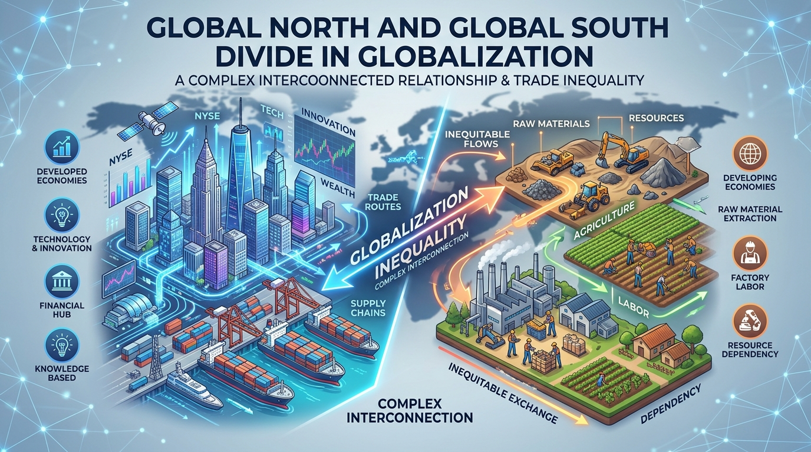



OBJECTIVES
ABOUT
WORDS TO GO BY
I. GLOBAL SOUTH

Slide 2
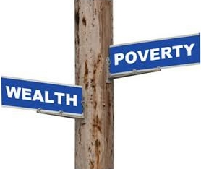
DISCUSS THE DIMESIONS OF GLOBAL DIVIDE
EXPLAIN COMPETING PERSPECTIVES ON THE GLOBAL DIVIDE; AND
ABOUT
LEARNING OUTCOMES
WORDS TO GO BY
I. GLOBAL SOUTH
EVALUATE THE IMPACT OF GLOBALIZATION ON THE GLOBAL DIVIDE.

Slide 3

Starter Activity:
Spend 3 minutes with the person next to you, talking about the following photos.
Think about how different life is in the UK and in poorer countries like the ones shown in the continent of Africa.

Slide 4
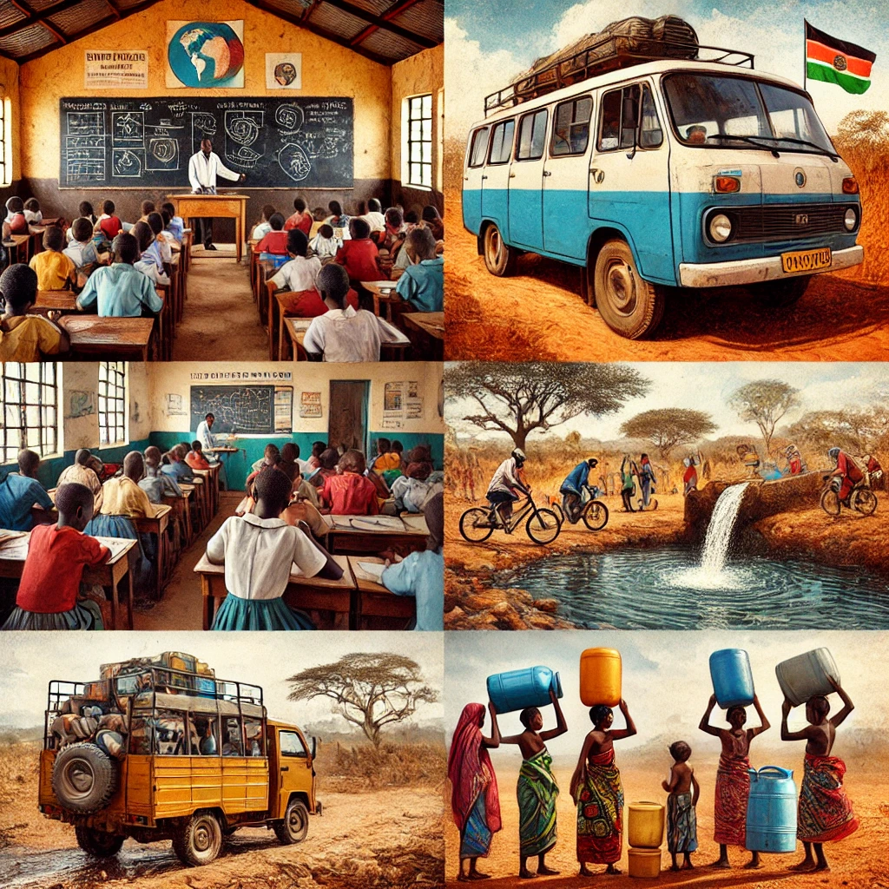
Africa

Slide 5
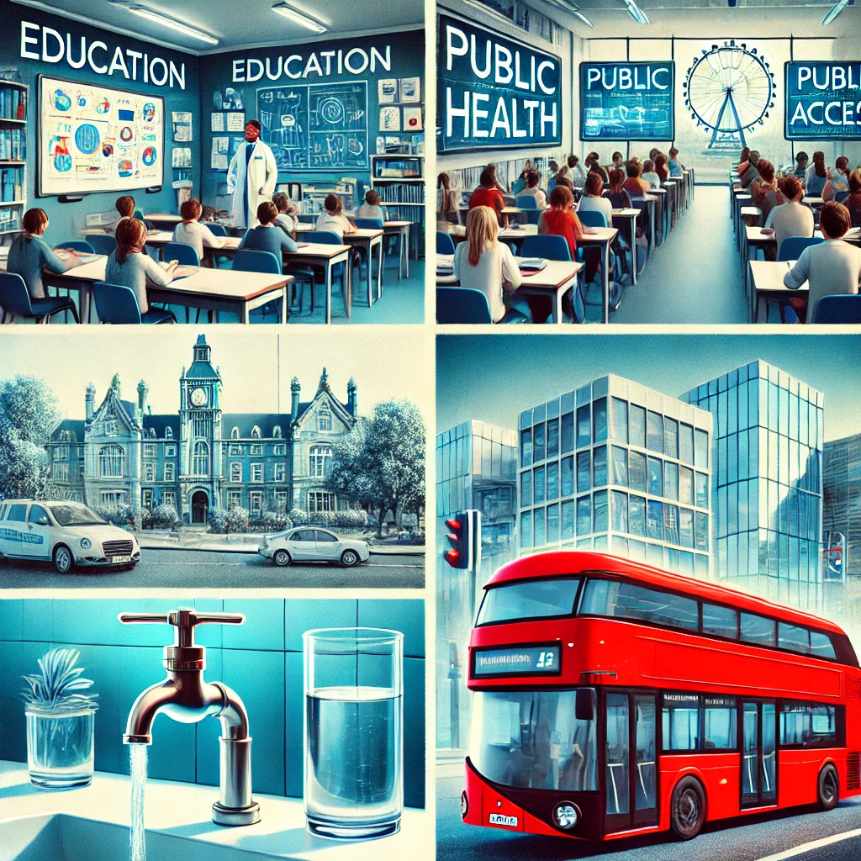
United Kingdom

Slide 6



FIRST WORLD
THIRD WORLD
NEOCOLONIALISM
ABOUT
OBJECTIVES
I. GLOBAL SOUTH
WORDS TO GO BY

Slide 7
AUSTERITY
ABSOLUTE POVERTY
REGIONALISM
ABOUT
OBJECTIVES
I. GLOBAL SOUTH
WORDS TO GO BY

Slide 8
FIRST WORLD
Countries that are industrialized and developed
THIRD WORLD
OBJECTIVES
ABOUT
I. GLOBAL SOUTH
WORDS TO GO BY
Countries that are mostly developing, non-industrialized or semi-industrialized
NEOCOLONIALISM
From indirect colonialism in which a neocolony is dominated, economically, culturally, or politically by a more powerful country

Slide 9
AUSTERITY
policy of cutting budget for social services, so as to reduce a country’s budget deficit.
ABSOLUTE POVERTY
OBJECTIVES
ABOUT
I. GLOBAL SOUTH
WORDS TO GO BY
According to the World Bank, absolute poverty (commonly referred to by the organization as extreme poverty) is defined as a condition characterized by severe deprivation of basic human needs, including food, safe drinking water, sanitation facilities, health, shelter, education, and information.
REGIONALISM
process of closer economic integration of countries within a region (oftentimes, culturally and geographically linked countries).

Slide 10
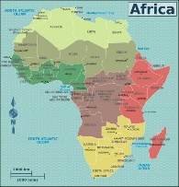
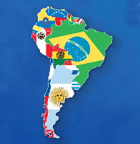
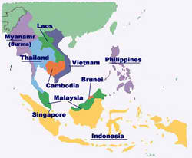
AFRICA
LATIN AMERICA
DEVELOPING ASIA
“Developing Countries”
OBJECTIVES
ABOUT
I. GLOBAL SOUTH
WORDS TO GO BY
The Global South is more than the extension of a “metaphor for underdeveloped countries.” In general, it refers to the countries’ interconnected histories of colonialism, neo-imperialism, and differential economic and social change through which large inequalities in living standards, life expectancy, and access to resources are maintained.

Slide 11
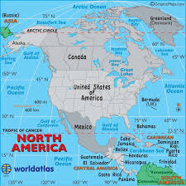
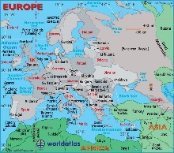
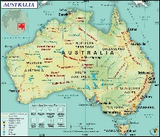
NORTH AMERICA
EUROPE
AUSTRALIA
“Developed Countries”
OBJECTIVES
ABOUT
WORDS TO GO BY
I. GLOBAL NORTH
The Global North refers to developed societies of Europe and North America, which are characterized by established democracy, wealth, technological advancement, political stability, aging population, zero population growth and dominance of world trade and politics.

Slide 12
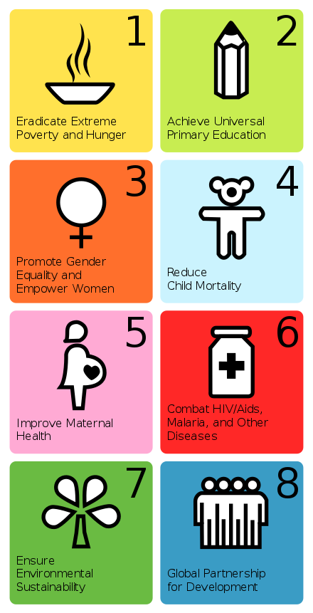
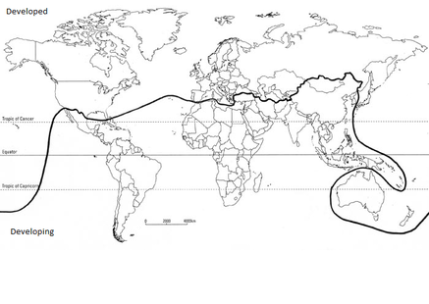
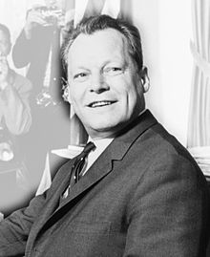
These goals seek to:
II. THE GAP BETWEEN THE GLOBAL NORTH AND GLOBAL SOUTH
Availability of natural resources
Different levels of health and education
The nature of a country’s economy and its industrial sectors
International trading policies and access to markets
How countries are governed and international relationships between countries
Conflict within and between countries; and
A country’s vulnerability to natural hazards and climate change
The United Nations established its role in diminishing the divide between North and South through the Millennium Development Goals.
In economic terms, the North—with one quarter of the world population—controls four-fifths of the income earned anywhere in the world. 90% of the manufacturing industries are owned by and located in the North.
Economists have argued that international free trade and unhindered capital flows across countries could lead to a contraction in the North – South divide. In this case more equal trade and flow of capital would allow the possibility for developing countries to further develop economically.
MILLENNIUM DEVELOPMENT GOALS
CAUSES OF INEQUALITIES
BRANDT LINE
FUTURE DEVELOPMENTS
Inversely, the South—with three quarter of the world populations—has access to one-fifth of the world income. As nations become economically developed, they may become part of the North; similarly, any nations that do not qualify for developed status are in effect to be part of the south.
A visual depiction on understanding the drastic differences in the economic development for both the North and South hemispheres of the world based on GDP per capita, proposed by Willy Brandt in the 1980 through the Brandt Report.

Slide 13
III. CONCEPTIONS OF GLOBAL RELATIONS
Major Premise: The Underdevelopment of Certain States or Peoples and their Lack of Representation in Global Political Process is a Reality.
Prevalent: Imbalances of Aggregate Economic and Political Power Between States.
  Interstate Dimension
FACTS
MAJOR THEORIES
CONSTRUCTIVISM
LIBERALISM
MARXISM
REALISM
The Starbucks and the Shanty:
  Spaces of Underdevelopment in Developed Countries may Mirror the Poverty of the Global South, and Spaces of Affluence in the Developing World Mirror those of the Global North
  The Global South is Everywhere, but it is also Somewhere, and that Somewhere, Located at the Intersection of Entangled Political Geographies of Dispossession and Repossession
Notes:
"The Starbucks and the Shanty"
Spaces of Underdevelopment in Developed Countries vs. Spaces of Affluence in the Developing World
This concept challenges the simplistic geographic view that the "Global North" is universally rich and the "Global South" is universally poor. Instead, it highlights that global inequality exists within nations, not just between them.
Spaces of Affluence in the Global South: Enclaves of extreme wealth—gated communities, financial districts, luxury high-rises, and international chains like Starbucks—exist in cities like Mumbai, Nairobi, or Manila. These spaces mirror the living standards, consumption patterns, and insulation of the Global North.
Spaces of Underdevelopment in the Global North: Pockets of extreme poverty, informal housing, food deserts, and systemic neglect—"shanties" or disenfranchised communities—exist in cities like Detroit, Paris, or London. These spaces experience the same structural marginalization and lack of resources typically associated with the Global South.
Core Idea: Wealth and poverty are spatially fragmented. "North" and "South" are no longer just places on a map, but conditions of privilege or disenfranchisement that exist side-by-side everywhere.

Slide 14
INTERNATIONAL RELATIONS
III. CONCEPTIONS OF GLOBAL RELATIONS
Major Premise: The Underdevelopment of Certain States or Peoples and their Lack of Representation in Global Political Process is a Reality
Prevalent: Imbalances of Aggregate Economic and Political Power Between States
  Interstate Dimension
REALISM
LIBERALISM
FACTS
MAJOR THEORIES
CONSTRUCTIVISM
LIBERALISM
MARXISM
REALISM
The Starbucks and the Shanty:
  Spaces of Underdevelopment in Developed Countries may Mirror the Poverty of the Global South, and Spaces of Affluence in the Developing World Mirror those of the Global North
  The Global South is Everywhere, but it is also Somewhere, and that Somewhere, Located at the Intersection of Entangled Political Geographies of Dispossession and Repossession
MARXISM
CONSTRUCTIVISM

Slide 15
INTERNATIONAL RELATIONS
III. CONCEPTIONS OF GLOBAL RELATIONS
Major Premise: The Underdevelopment of Certain States or Peoples and their Lack of Representation in Global Political Process is a Reality
Prevalent: Imbalances of Aggregate Economic and Political Power Between States
  Interstate Dimension
Generally assumes that the international system is inherently disorderly and relations are anarchic because primary actors are perpetually locked against a struggle for power and security.
The behaviours and actions of these states are directed toward the promotion of their self-interest. There can be no middle ground or moderation with regard to the scope of power accumulation. A state either has power or none at all.
REALISM
LIBERALISM
MARXISM
MAJOR THEORIES
FACTS
CONSTRUCTIVISM
LIBERALISM
REALISM
The Starbucks and the Shanty:
  Spaces of Underdevelopment in Developed Countries may Mirror the Poverty of the Global South, and Spaces of Affluence in the Developing World Mirror those of the Global North
  The Global South is Everywhere, but it is also Somewhere, and that Somewhere, Located at the Intersection of Entangled Political Geographies of Dispossession and Repossession
MARXISM
CONSTRUCTIVISM
Notes:
1. Realism
Core View: International relations is a struggle for power and survival in an anarchic world (a world with no global government).
Key Assumption: States are the primary, rational actors. They operate under zero-sum competition, driven by national interest and security.
Key Concept: Balance of power and military capability dictate global peace and conflict.

Slide 16
INTERNATIONAL RELATIONS
III. CONCEPTIONS OF GLOBAL RELATIONS
Major Premise: The Underdevelopment of Certain States or Peoples and their Lack of Representation in Global Political Process is a Reality
Prevalent: Imbalances of Aggregate Economic and Political Power Between States
  Interstate Dimension
A theory based on the same economic theory that emerged from the works of Karl Marx.
Note that realism and liberalism are politics-centric theories of international relations.
Specifically argues that the instability in the international system results from different facets of class struggle such as the problems due to:
  Capitalism
  Exploitation of resources by the few
  Uneven distribution of wealth; and
  The institutionalization of inequality and injustice
Generally assumes that the international system is inherently disorderly and relations are anarchic because primary actors are perpetually locked against a struggle for power and security.
The behaviours and actions of these states are directed toward the promotion of their self-interest. There can be no middle ground or moderation with regard to the scope of power accumulation. A state either has power or none at all.
REALISM
LIBERALISM
FACTS
MAJOR THEORIES
CONSTRUCTIVISM
LIBERALISM
MARXISM
REALISM
The Starbucks and the Shanty:
  Spaces of Underdevelopment in Developed Countries may Mirror the Poverty of the Global South, and Spaces of Affluence in the Developing World Mirror those of the Global North
  The Global South is Everywhere, but it is also Somewhere, and that Somewhere, Located at the Intersection of Entangled Political Geographies of Dispossession and Repossession
MARXISM
CONSTRUCTIVISM
Notes:
4. Marxism
Core View: International relations is driven by economic forces, class struggle, and global capitalist exploitation.
Key Assumption: The global system is organized into a hierarchy where wealthy core states exploit peripheral developing states for labor and resources.
Key Concept: Core vs. Periphery dynamics and the inequality of global capital.

Slide 17
INTERNATIONAL RELATIONS
III. CONCEPTIONS OF GLOBAL RELATIONS
Major Premise: The Underdevelopment of Certain States or Peoples and their Lack of Representation in Global Political Process is a Reality
Prevalent: Imbalances of Aggregate Economic and Political Power Between States
  Interstate Dimension
A theory based on the same economic theory that emerged from the works of Karl Marx.
Note that realism and liberalism are politics-centric theories of international relations.
Specifically argues that the instability in the international system results from different facets of class struggle such as the problems due to:
  Capitalism
  Exploitation of resources by the few
  Uneven distribution of wealth; and
  The institutionalization of inequality and injustice
Generally assumes that the international system is inherently disorderly and relations are anarchic because primary actors are perpetually locked against a struggle for power and security.
The behaviours and actions of these states are directed toward the promotion of their self-interest. There can be no middle ground or moderation with regard to the scope of power accumulation. A state either has power or none at all.
REALISM
LIBERALISM
General assumptions of liberalism center on the notion that the rejection of power politics is the only possible outcome of international relations.
States are not the only primary actors in the international politics according to liberalism. International organizations such as supranational authorities and non-government organizations to include business organizations and non-profit organizations play critical roles in shaping international relations.
FACTS
MAJOR THEORIES
CONSTRUCTIVISM
LIBERALISM
MARXISM
REALISM
The Starbucks and the Shanty:
  Spaces of Underdevelopment in Developed Countries may Mirror the Poverty of the Global South, and Spaces of Affluence in the Developing World Mirror those of the Global North
  The Global South is Everywhere, but it is also Somewhere, and that Somewhere, Located at the Intersection of Entangled Political Geographies of Dispossession and Repossession
MARXISM
CONSTRUCTIVISM
Notes:
Liberalism
Core View: Cooperation, peace, and progress are possible through international institutions, democracy, and economic interdependence.
Key Assumption: States are not the only actors; non-state actors, international organizations (like the UN or WTO), and non-governmental networks shape global outcomes.
Key Concept: Absolute gains (everyone can benefit through trade and diplomacy) and rule-based global governance.

Slide 18
INTERNATIONAL RELATIONS
III. CONCEPTIONS OF GLOBAL RELATIONS
Major Premise: The Underdevelopment of Certain States or Peoples and their Lack of Representation in Global Political Process is a Reality
Prevalent: Imbalances of Aggregate Economic and Political Power Between States
  Interstate Dimension
A theory based on the same economic theory that emerged from the works of Karl Marx.
Note that realism and liberalism are politics-centric theories of international relations.
Specifically argues that the instability in the international system results from different facets of class struggle such as the problems due to:
  Capitalism
  Exploitation of resources by the few
  Uneven distribution of wealth; and
  The institutionalization of inequality and injustice
Generally assumes that the international system is inherently disorderly and relations are anarchic because primary actors are perpetually locked against a struggle for power and security.
The behaviours and actions of these states are directed toward the promotion of their self-interest. There can be no middle ground or moderation with regard to the scope of power accumulation. A state either has power or none at all.
Considers international politics as a real of interaction influenced by the identities and practices of actors and directed further by the incessantly changing norms.
The motivation behind the behaviours and actions of a state is shaped by their interactions with other states and actors
Constructionism perceives these actors as social beings whose identities and interests are the product of social structures.
REALISM
LIBERALISM
General assumptions of liberalism center on the notion that the rejection of power politics is the only possible outcome of international relations.
States are not the only primary actors in the international politics according to liberalism. International organizations such as supranational authorities and non-government organizations to include business organizations and non-profit organizations play critical roles in shaping international relations.
FACTS
CONSTRUCTIVISM
MAJOR THEORIES
LIBERALISM
MARXISM
REALISM
The Starbucks and the Shanty:
  Spaces of Underdevelopment in Developed Countries may Mirror the Poverty of the Global South, and Spaces of Affluence in the Developing World Mirror those of the Global North
  The Global South is Everywhere, but it is also Somewhere, and that Somewhere, Located at the Intersection of Entangled Political Geographies of Dispossession and Repossession
MARXISM
CONSTRUCTIVISM
Notes:
Constructivism
Core View: Global politics is shaped by shared ideas, identities, values, and social interactions, rather than static material power.
Key Assumption: "Anarchy is what states make of it." Threats, alliances, and norms are social constructs that change over time as societies and leaders evolve.
Key Concept: Norms, identity, and shared meaning dictate how states perceive friend vs. foe.

Slide 19
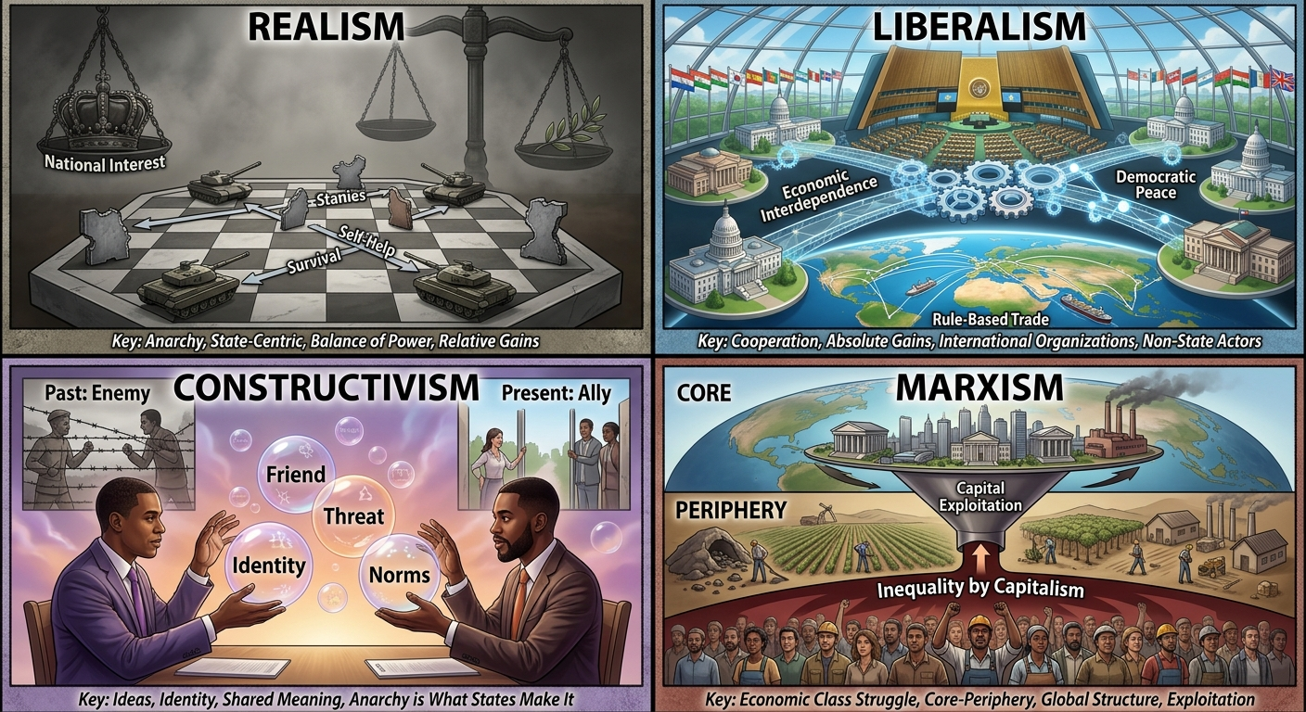
INTERNATIONAL RELATIONS
III. CONCEPTIONS OF GLOBAL RELATIONS
Major Premise: The Underdevelopment of Certain States or Peoples and their Lack of Representation in Global Political Process is a Reality
Prevalent: Imbalances of Aggregate Economic and Political Power Between States
  Interstate Dimension
A theory based on the same economic theory that emerged from the works of Karl Marx.
Note that realism and liberalism are politics-centric theories of international relations.
Specifically argues that the instability in the international system results from different facets of class struggle such as the problems due to:
  Capitalism
  Exploitation of resources by the few
  Uneven distribution of wealth; and
  The institutionalization of inequality and injustice
Generally assumes that the international system is inherently disorderly and relations are anarchic because primary actors are perpetually locked against a struggle for power and security.
The behaviours and actions of these states are directed toward the promotion of their self-interest. There can be no middle ground or moderation with regard to the scope of power accumulation. A state either has power or none at all.
REALISM
LIBERALISM
General assumptions of liberalism center on the notion that the rejection of power politics is the only possible outcome of international relations.
States are not the only primary actors in the international politics according to liberalism. International organizations such as supranational authorities and non-government organizations to include business organizations and non-profit organizations play critical roles in shaping international relations.
FACTS
COMPARISON
MAJOR THEORIES
LIBERALISM
MARXISM
REALISM
The Starbucks and the Shanty:
  Spaces of Underdevelopment in Developed Countries may Mirror the Poverty of the Global South, and Spaces of Affluence in the Developing World Mirror those of the Global North
  The Global South is Everywhere, but it is also Somewhere, and that Somewhere, Located at the Intersection of Entangled Political Geographies of Dispossession and Repossession
MARXISM
CONSTRUCTIVISM

Slide 20
INTERNATIONAL RELATIONS
III. CONCEPTIONS OF GLOBAL RELATIONS
Globalism (Steger): Global economic integration is not only inevitable given the rise of new technologies; it is more importantly, a normative international goal.
Civilization Discourse: Dominant ideology of colonialism and the logic that shaped the birth of the international order
Modernization Theory (Rostow): Outlined historical progress in terms of a society’s capacity to produce and consume material goods.
Clash of Civilizations (Huntington): A clash of civilization is the main source of conflict in the post-cold war world
End of History (Fukuyama): The complete triumph of western capitalism and liberalism turns the west into the telos of political organization, which all must aspire to
The Lexus (Friedman): Global progress in terms of a binary between embracing free trade and being left behind by the pace of international economic and technological development. The alternative to Lexus is stagnation, making injunction to globalize an imperative in the quest for global modernity
Challenging the Global Order:
  Lenin: Capitalism’s strength is premised on the creation of new markets via imperialism
  Sukarno: Colonialism has also its modern dress, in the form of economic control, intellectual control, actual physical control by a small but alien community within a nation. It is a skilful and determined enemy, it appears in many guises
  Third Worldism: Began as common resistance to new forms of colonialism
Major Premise: The Underdevelopment of Certain States or Peoples and their Lack of Representation in Global Political Process is a Reality
Prevalent: Imbalances of Aggregate Economic and Political Power Between States
  Interstate Dimension
A theory based on the same economic theory that emerged from the works of Karl Marx.
Note that realism and liberalism are politics-centric theories of international relations.
Specifically argues that the instability in the international system results from different facets of class struggle such as the problems due to:
  Capitalism
  Exploitation of resources by the few
  Uneven distribution of wealth; and
  The institutionalization of inequality and injustice
Generally assumes that the international system is inherently disorderly and relations are anarchic because primary actors are perpetually locked against a struggle for power and security.
The behaviours and actions of these states are directed toward the promotion of their self-interest. There can be no middle ground or moderation with regard to the scope of power accumulation. A state either has power or none at all.
Considers international politics as a real of interaction influenced by the identities and practices of actors and directed further by the incessantly changing norms.
The motivation behind the behaviours and actions of a state is shaped by their interactions with other states and actors
Constructionism perceives these actors as social beings whose identities and interests are the product of social structures.
REALISM
LIBERALISM
General assumptions of liberalism center on the notion that the rejection of power politics is the only possible outcome of international relations.
States are not the only primary actors in the international politics according to liberalism. International organizations such as supranational authorities and non-government organizations to include business organizations and non-profit organizations play critical roles in shaping international relations.
Pro-Globalist & Western Hegemony Paradigms
CONSTRUCTIVISM
MAJOR THEORIES
LIBERALISM
MARXISM
REALISM
The Starbucks and the Shanty:
  Spaces of Underdevelopment in Developed Countries may Mirror the Poverty of the Global South, and Spaces of Affluence in the Developing World Mirror those of the Global North
  The Global South is Everywhere, but it is also Somewhere, and that Somewhere, Located at the Intersection of Entangled Political Geographies of Dispossession and Repossession
MARXISM
CONSTRUCTIVISM
Notes:
tPro-Globalist & Western Hegemony Paradigms
1. Globalism (Steger)
Explanation: Globalism goes beyond simple economic connectivity; it is an ideology asserting that global economic integration is both an unchangeable reality driven by technology and a moral goal everyone should strive for. It frames free markets and open borders as the ideal pathway to global prosperity.
2. Civilizational Discourse
Explanation: The historical ideology used to justify Western imperialism. It categorized the world into "civilized," "barbaric," and "savage" societies, creating a racial and cultural hierarchy. This logic declared that European powers had a "civilizing mission" (mission civilisatrice) to govern, exploit, and reshape non-Western peoples under the guise of progress.
3. Modernization Theory (Rostow)
Explanation: A Cold War-era framework arguing that all nations follow a single, linear evolutionary path toward progress: moving from a "traditional society" to a high-mass consumption economy like that of the United States. It measures a nation's maturity almost entirely by its capacity to industrially produce and consume material goods.
4. Clash of Civilizations (Huntington)
Explanation: A post-Cold War thesis arguing that future global conflicts would no longer be fought over political ideologies (like Capitalism vs. Communism) or state interests alone, but along cultural and religious fault lines. It views civilizations—such as Western, Islamic, Sinic, and Orthodox—as distinct, incompatible blocs prone to inevitable friction.
5. End of History (Fukuyama)
Explanation: Proposed after the fall of the Soviet Union, this thesis argues that Western liberal democracy and market capitalism represent the ultimate endpoint (telos) of human socio-political evolution. In this view, major ideological battles are over, and all states will eventually converge on Western-style democratic capitalism.
6. The Lexus and the Olive Tree (Friedman)
Explanation: A metaphor for the choices facing nations in a hyper-connected world. "The Lexus" represents global integration, modern technology, free trade, and economic efficiency, while "The Olive Tree" represents local identity, tradition, and roots. Friedman argues that adopting "The Lexus" is an absolute imperative for modernity—a country must either submit to the fast-paced rules of global free-market capitalism or be left behind in poverty and stagnation.
Challenging the Global Order (Anti-Imperialist & Southern Counter-Perspectives)
7. Lenin’s Theory of Imperialism
Explanation: Vladimir Lenin argued that imperialism is not merely a foreign policy choice, but the highest stage of capitalism. As domestic markets become saturated and profit margins drop at home, capitalist nation-states are forced to invade and colonize foreign lands to secure new markets, cheap labor, and raw materials, exporting capital abroad to avoid economic collapse at home.
8. Sukarno’s "Modern Dress" Colonialism (Neo-Colonialism)
Explanation: Indonesian President Sukarno warned during the 1955 Bandung Conference that formal political independence does not mean colonialism is dead. Instead, colonialism adapts into neo-colonialism—exerting influence through indirect means like foreign economic leverage, debt traps, media dominance, and elite political manipulation without needing direct military occupation.
9. Third Worldism
Explanation: A political movement and ideology that emerged during the Cold War among newly independent nations in Africa, Asia, and Latin America. Rejecting alignment with either the US (First World) or USSR (Second World), Third Worldism sought collective solidarity to resist neo-colonialism, build economic self-reliance, and demand structural reforms to the Western-dominated international order.

Slide 21
CONCLUSION
The South continues to be globalized.
The Global south has provided models of resistance for the world.
As global problems intensify, it becomes more and more necessary for people in the north to support alternatives from the south.
Emphasis on the state and interstate politics remains politically and analytically relevant most especially in addressing global inequalities.

Slide 22


